Slide 4
How to use the Game Board
Click the link of the selected category/point value
The link will open the question
A second hyperlink located on the question slide will reveal the answer
A hyperlink “Back to Game Board” link on the bottom left of the answer slide to return to the main game board
No need to use arrow keys! Always click the links to move to questions, answers and back game board.

Slide 5
Predators, Tigers and Bears, Oh My!​ | Arctic Adaptations​ | What a Wonderful Wolf​ | Bird Bonanza​ | Marine Mania​ | A Day In the Life​
200​ | 200​ | 200​ | 200​ | 200​ | 200
400​ | 400​ | 400​ | 400​ | 400​ | 400
600​ | 600​ | 600​ | 600​ | 600​ | 600​
800​ | 800​ | 800​ | 800​ | 800​ | 800​
1000​ | 1000​ | 1000​ | 1000​ | 1000​ | 1000​

Slide 6
Name 2 types of bears found in Alaska​

Slide 7
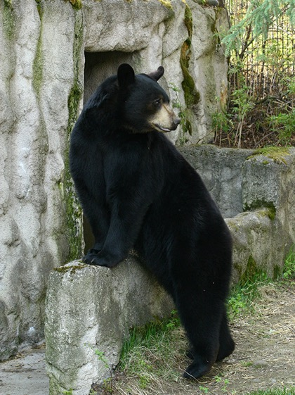
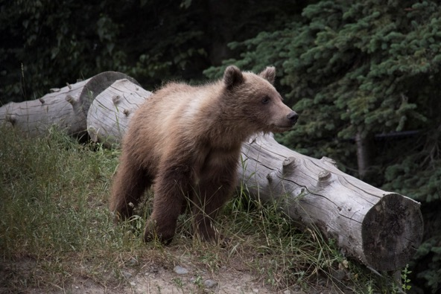
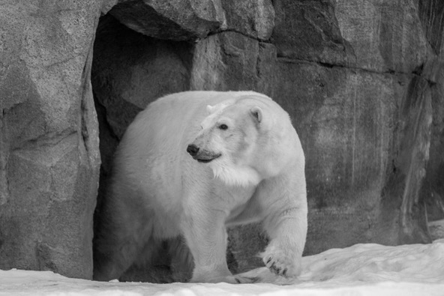
Name 2 types of bears found in Alaska​
Black Bear​
Brown Bear (Grizzly)
Polar Bear
Photos by John Gomes
Back to Game Board

Slide 8
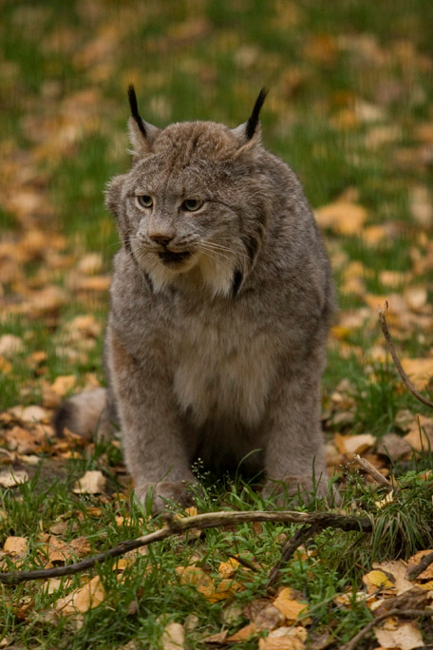
Carnivores eat…
Grass
Meat
Seeds and Berries
Spruce Needles
All of the above
Photo by John Gomes

Slide 9
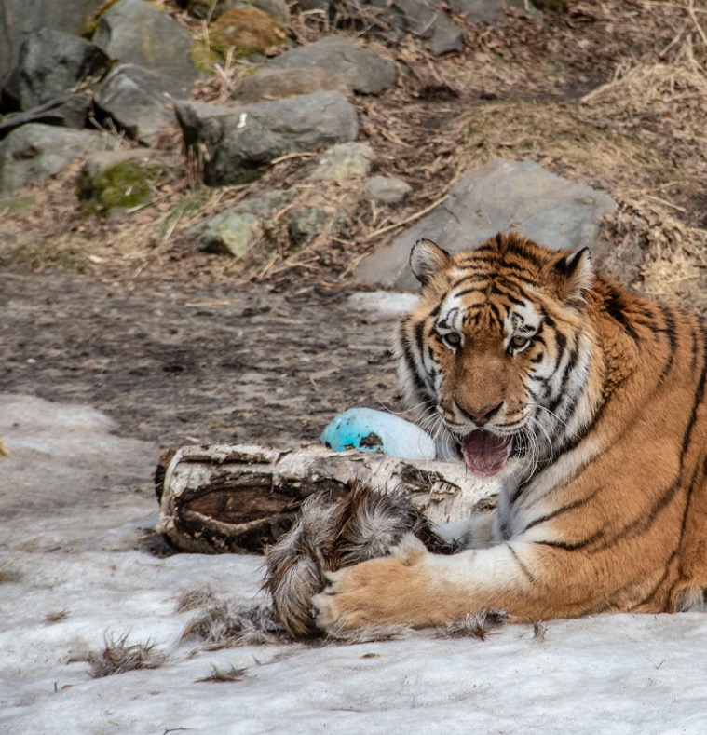
Carnivores eat…
Photo by John Gomes
Grass
Meat
Seeds and Berries
Pine Needles
All of the above
Back to Game Board

Slide 10
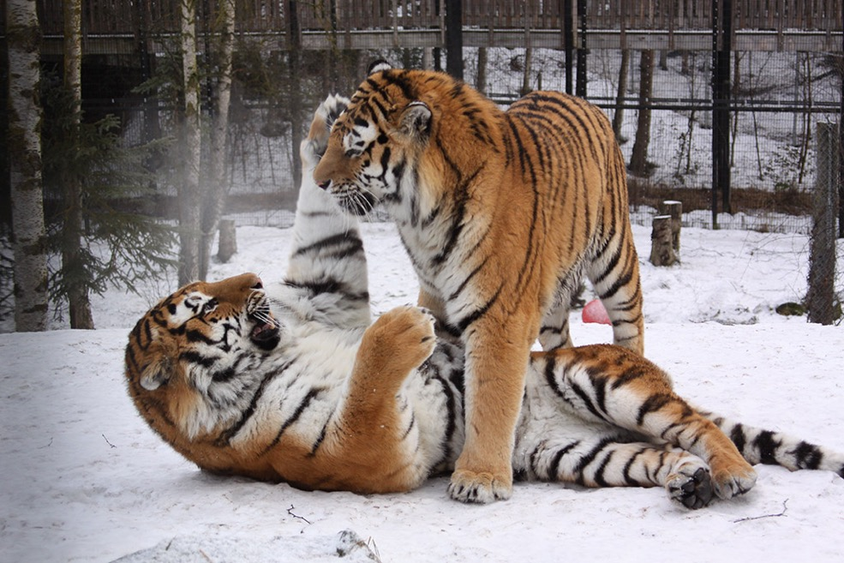
Amur Tigers are endangered…
What does “endangered” mean?
Common
Orange and Black
Rare
Extinct
Photo by John Gomes

Slide 11
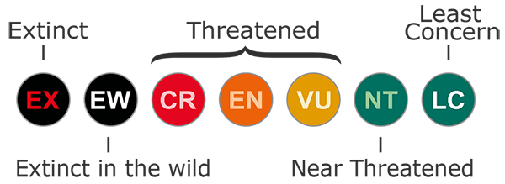
Amur Tigers are endangered…
What does “endangered” mean?
Common
Orange and Black
Rare
Extinct
IUCN scale of population status
Back to Game Board

Slide 12
Name this small, dog-like canine species by it’s sound
(Hint, you can find two of them at the Alaska Zoo!)

Slide 13
Coyote
Photo by John Gomes
Back to Game Board

Slide 14
Name the one species of bear that is a strict carnivore

Slide 15
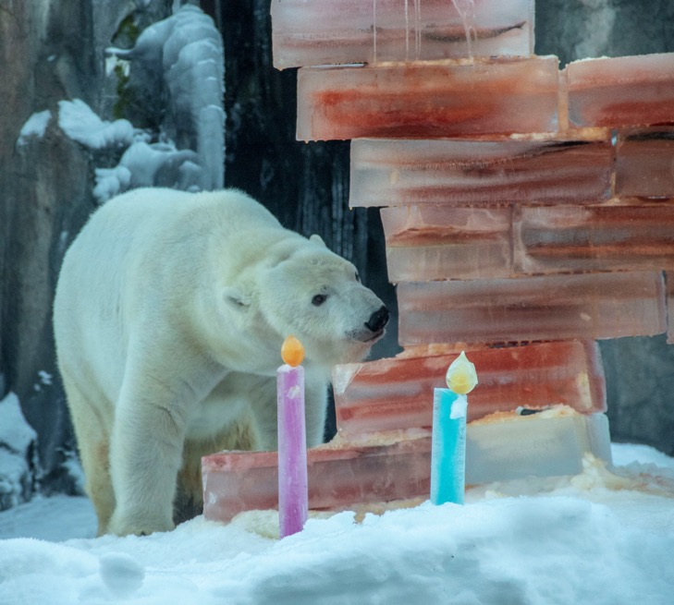
Polar Bear
BONUS QUESTION:
Earn 400 more points if you know what type of diet brown and black bears follow
Hint: they eat both plants and animals!
Photo by John Gomes

Slide 16
Omnivore – a diet of meat and plants
This adaptation of being able to eat almost anything has caused problems between humans and bears. Always use bear safe ways for storing trash!
Photo by John Gomes
Back to Game Board

Slide 17
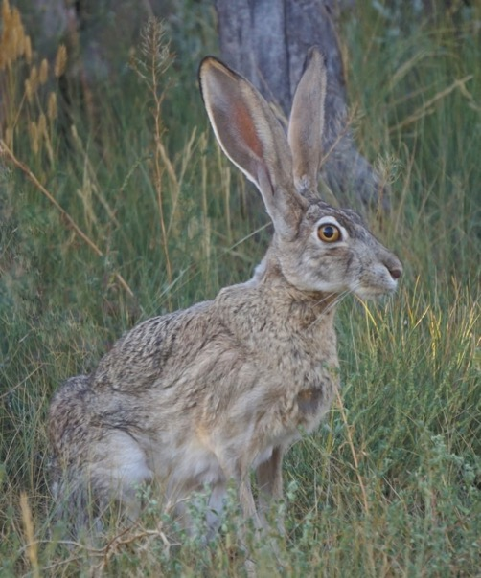
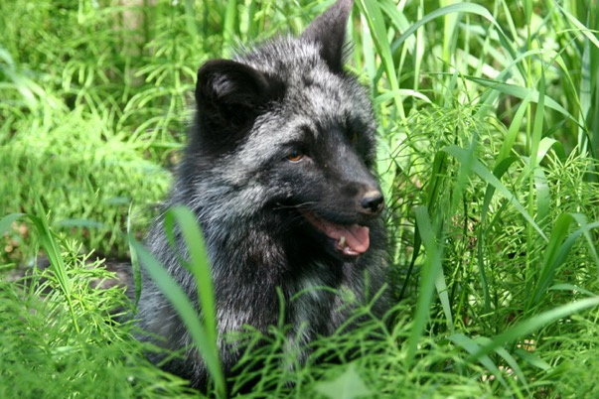
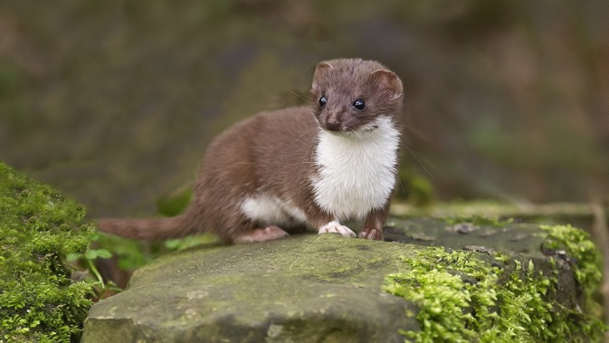
The Zoo has 3 animal types that change from brown to white in the winter months. What is this adaptation called when an animal’s color helps it blend in with its surroundings?
Arctic fox
Ermine
Arctic hare

Slide 18
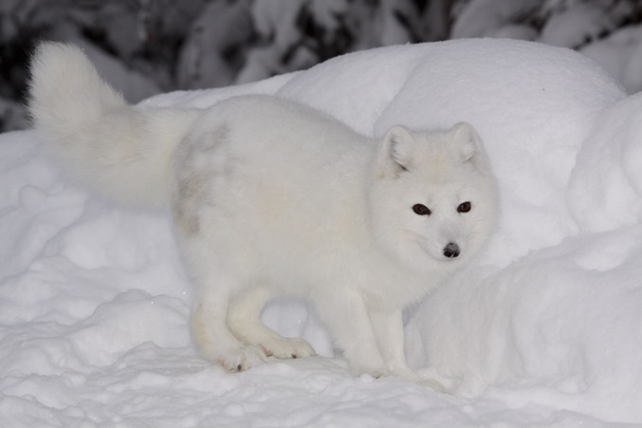
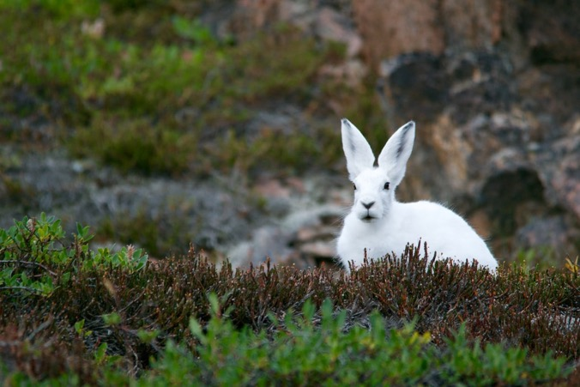
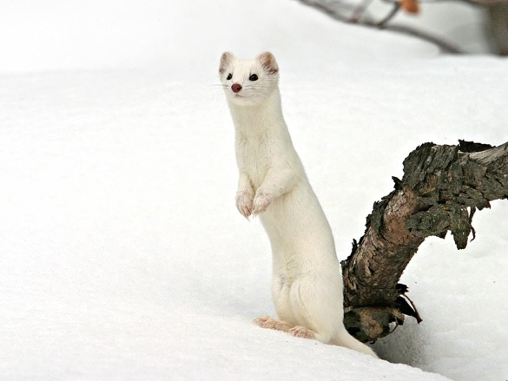
Camouflage
Arctic fox
Arctic hare
Ermine
Back to Game Board

Slide 19
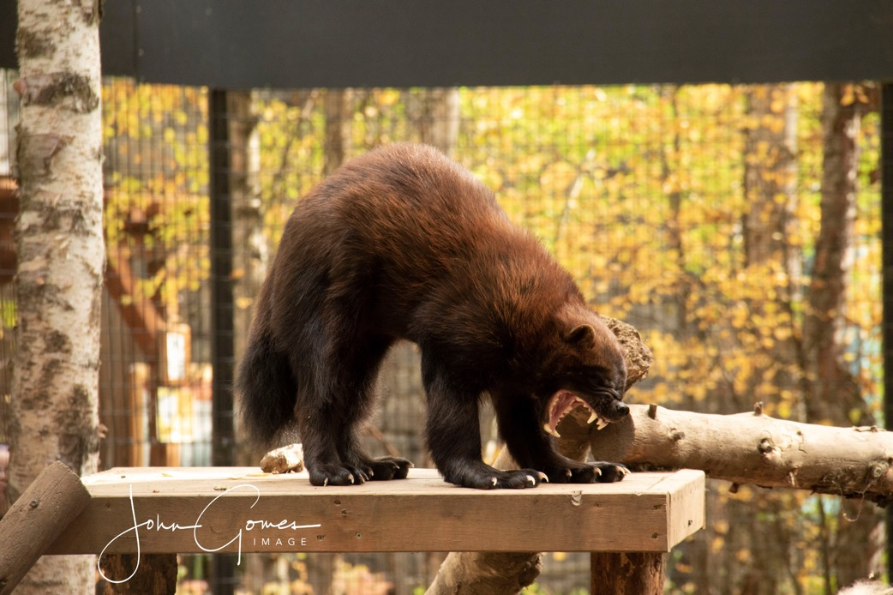
Because of food scarcity in the Arctic and sub-Arctic, the wolverine can be a hunter or a ________.
Scavenger
Herbivore
Insectivore
Crepuscular
Photo by John Gomes

Slide 20
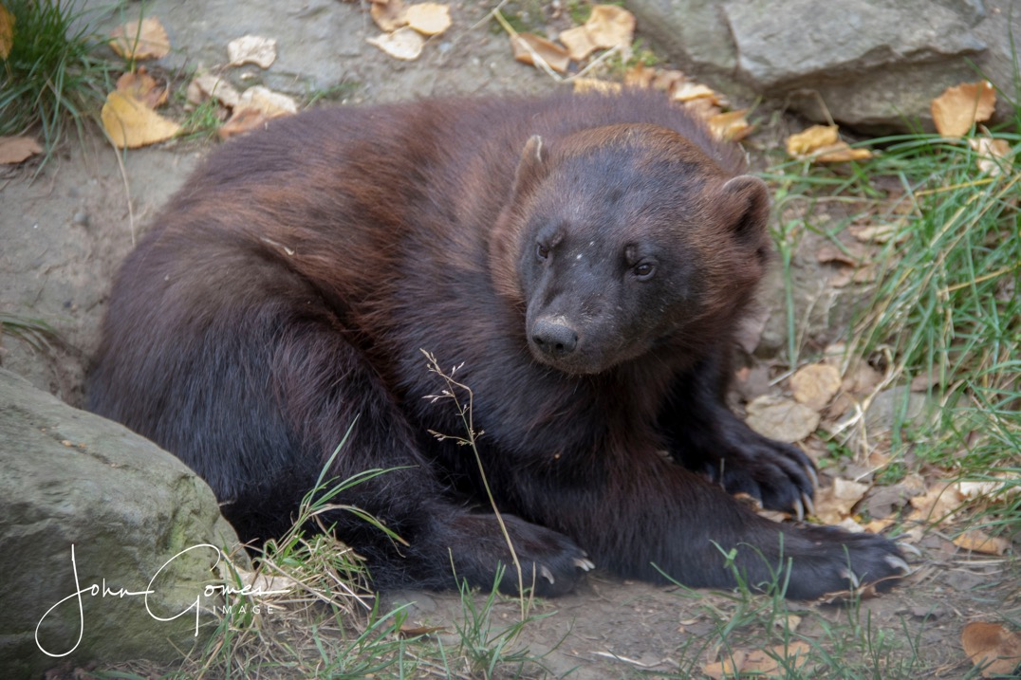
Because of food scarcity in the Arctic and sub-Arctic, the wolverine can be a hunter or a ________.
Scavenger
They eat anything
they can find.
Herbivore
Insectivore
Crepuscular
Photo by John Gomes
Back to Game Board

Slide 21
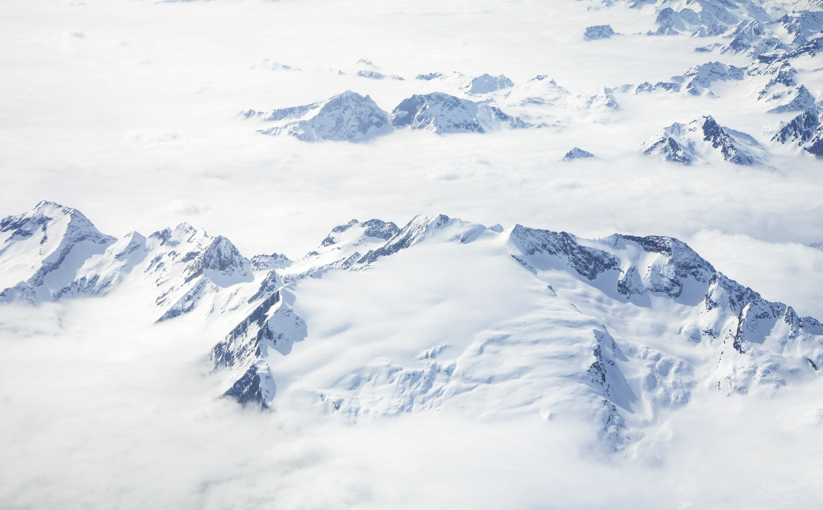
True or False?
Muskoxen have a winter undercoat that falls out as temperatures rise in spring and summer.

Slide 22
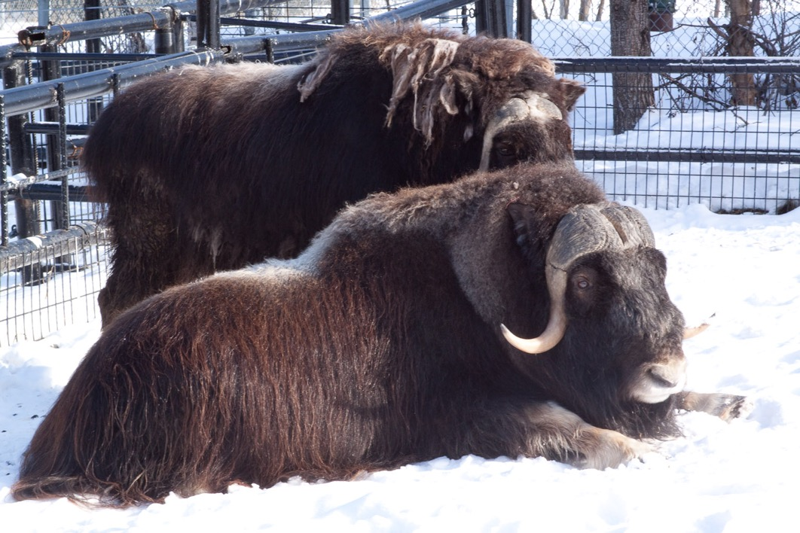
True!
Muskox shedding thick, fluffy undercoat as the temperature rises
Undercoat starting
to shed out
Back to Game Board

Slide 23
Name that animal!

Slide 24
Moose
Back to Game Board

Slide 25
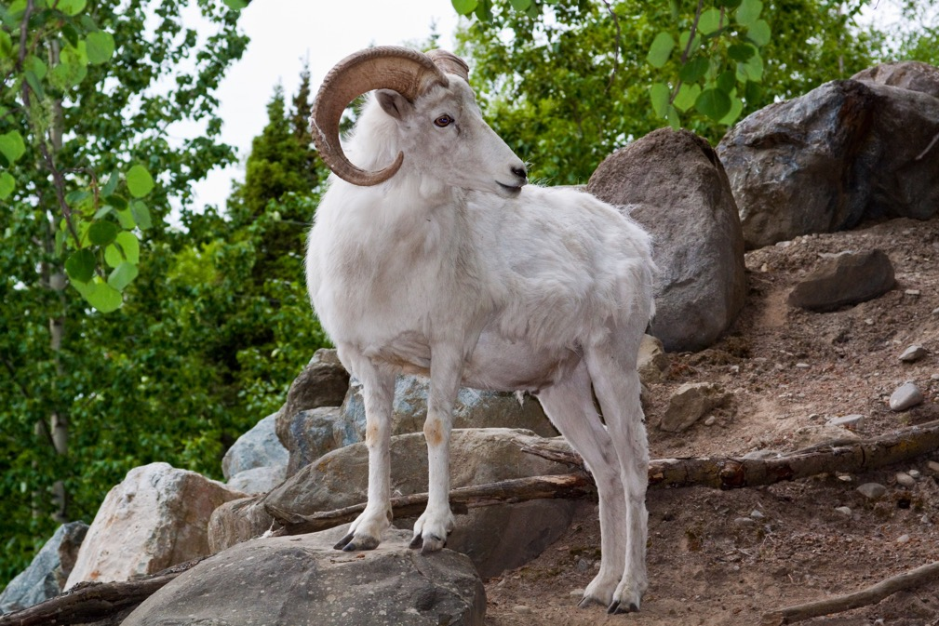
Dall’s sheep share their name from the ecologist, William Dall, who studied animals and their adaptations in Alaska.
Name the other Alaskan mammal that shares Dall’s name
HINT: It is a marine mammal related to whales and dolphins!

Slide 26
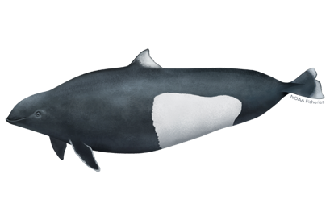
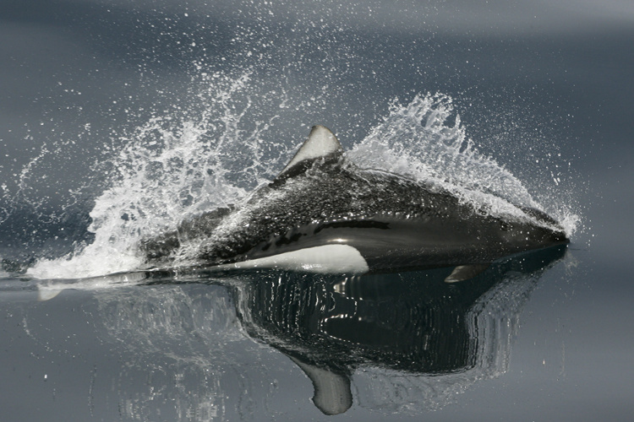
Dall’s Porpoise
Back to Game Board

Slide 27
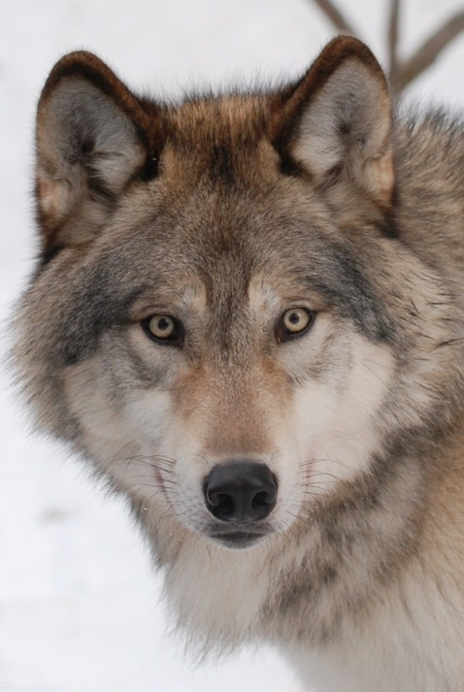
Name one animal that evolved from wolves
HINT: You have seen one before…

Slide 28
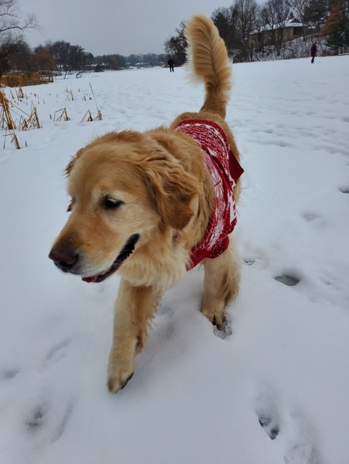
Dogs!
Dogs and modern wolves evolved from a common ancestor, domesticated by humans between 15,000 to 40,000 years ago.
Back to Game Board

Slide 29
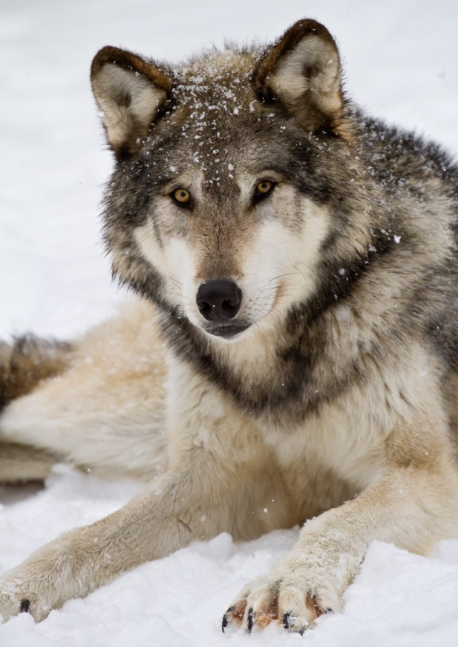
Wolves have a keen sense of _____ allowing them to identify territory find prey and socialize with other wolves.
Speech
Smell
Boundaries
Touch
Photo by John Gomes

Slide 30
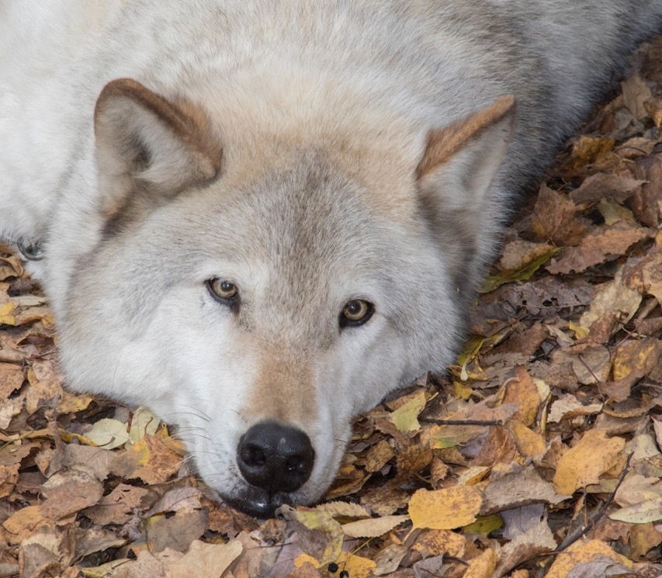
Wolves have a keen sense of _____ allowing them to identify territory, find prey and socialize with other wolves.
Photo by John Gomes
Speech
Smell
Boundaries
Touch
Back to Game Board

Slide 31
True or False?
Wolves travel in packs typically with female and male leaders and their offspring (babies).

Slide 32
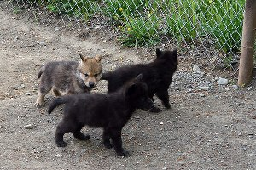
True!
Offspring may leave the pack when they reach maturity or if food becomes scarce.
Currently the 4 wolves at the zoo are all siblings (3 sisters, one brother) and stay together like family packs in the wild
Back to Game Board

Slide 33
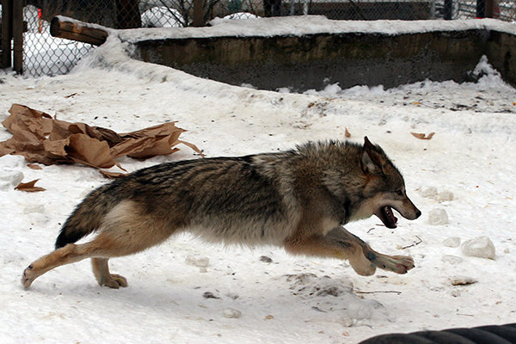
Subspecies refers to animals so closely related to each other through their DNA that they are not separate species. How many subspecies of wolf are there around the world?
2
70
25
1,000

Slide 34
Subspecies refers to animals so closely related to each other through their DNA that they are not separate species. How many subspecies of wolf are there around the world?
2
70
25
1,000
BONUS for 200 points:
How many subspecies of wolf live in Alaska?

Slide 35
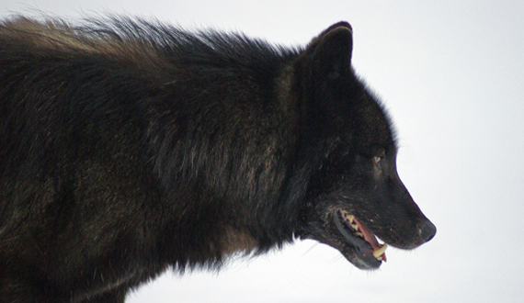
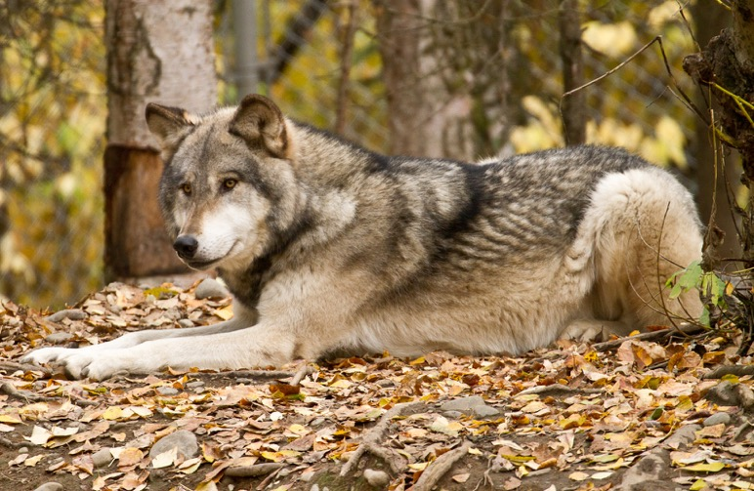
How many wolf subspecies live in Alaska?
2
Alexander Archipelago Wolf
Interior Alaskan Wolf
Back to Game Board

Slide 36
Wolf Howl
Listen to the wolf howl sound clip
What is one reason a wolf (or wolves) might howl?
Think about the wolf family structure and how large their habitat is

Slide 37
Wolves howl for many reasons
Locate others in their pack that may have travelled far looking for food
Marking territory - telling other wolf packs, “This is our territory. Stay out!”
Calling out to pack that an individual has found prey
Warning - about a larger predator/competing pack
Back to Game Board

Slide 38
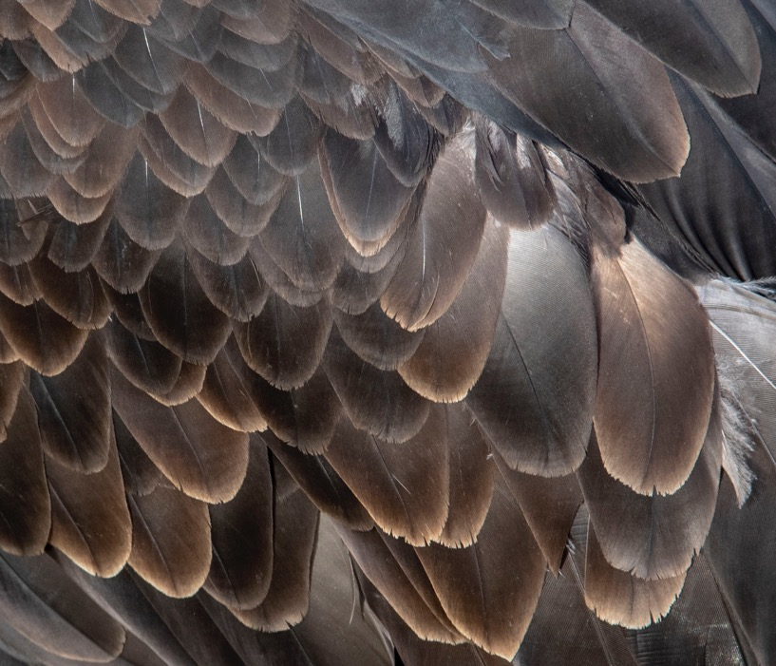
True or False?
Bald eagles are bald with no feathers on their heads.
Photo by John Gomes

Slide 39
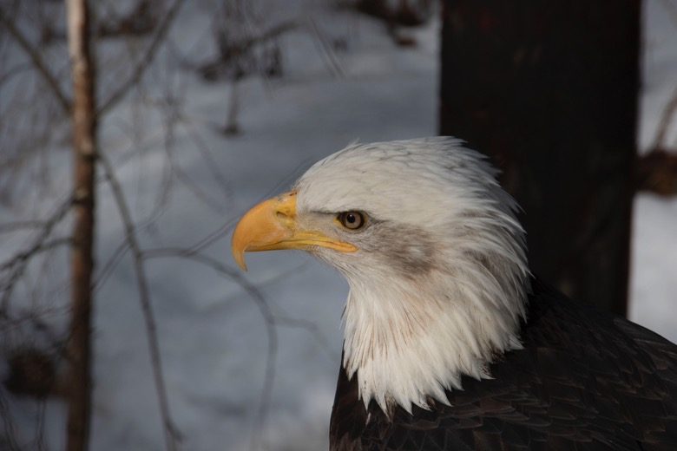
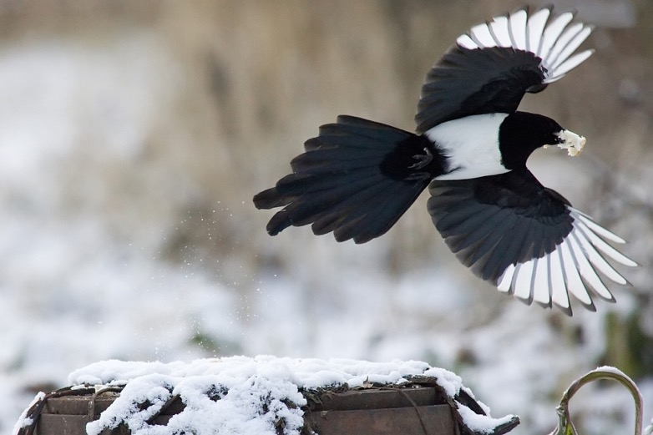
False!
Photo by John Gomes
Bald eagles have white feathers on their head and dark brown feathers on their bodies.
Bald eagles get their name from the adjective “piebald” describing an animal’s color pattern. Piebald animals have dark hair or feathers with white spots on top.
Fun Fact! Magpies also get their name from their “pied” or “piebald” coloring!
Back to Game Board

Slide 40
What is the largest owl species in Alaska?
Great Horned Owl
Short-Eared Owl
Raven
Great Gray Owl

Slide 41
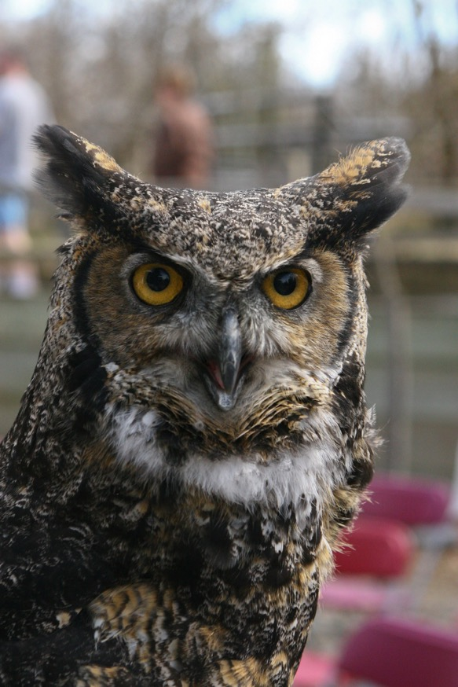
What is the largest owl species in Alaska?
Great Horned Owl
Short-Eared Owl
Raven
Great Gray Owl
Back to Game Board

Slide 42
Which statement is true about ravens?
They are the largest all black bird in the world.
They can be hunters or scavengers.
They can mimic sounds like water drops, car noises, other birds and human speech.
All the above are true.

Slide 43
Which statement is true about ravens?
They are the largest all black bird in the world.
They can be hunters or scavengers.
They can mimic sounds like water drops, car noises, other birds and human speech.
All the above are true.
Raven call
Back to Game Board

Slide 44
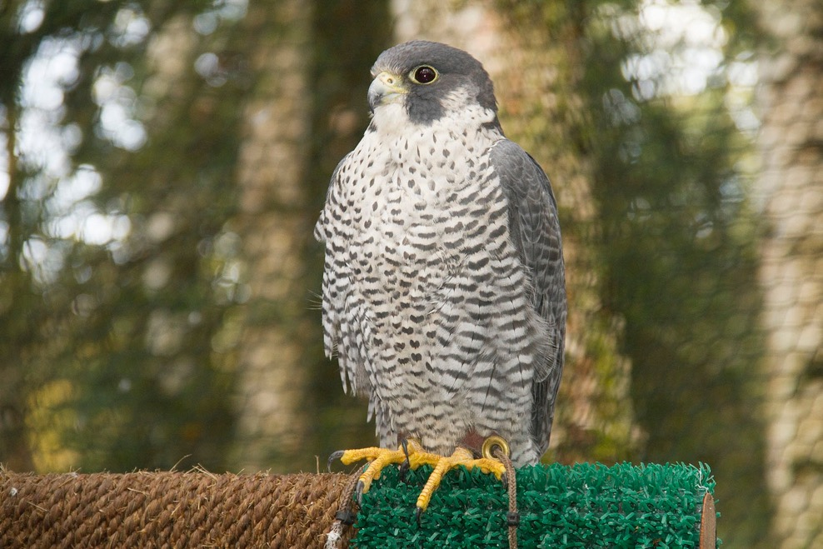
The Peregrine falcon can stoop (dive) at a speed of up to…
10 mph
45 mph
1,000,000 mph
200 mph
Photo by John Gomes

Slide 45
The Peregrine falcon can stoop (dive) at a speed of up to…
10 mph
45 mph
1,000,000 mph
200 mph: About as fast as an arrow shooting from a bow!
Back to Game Board

Slide 46
The heaviest bird in North America is the…
Great horned owl
Golden Eagle
Trumpeter Swan
Sharp-shinned Hawk

Slide 47
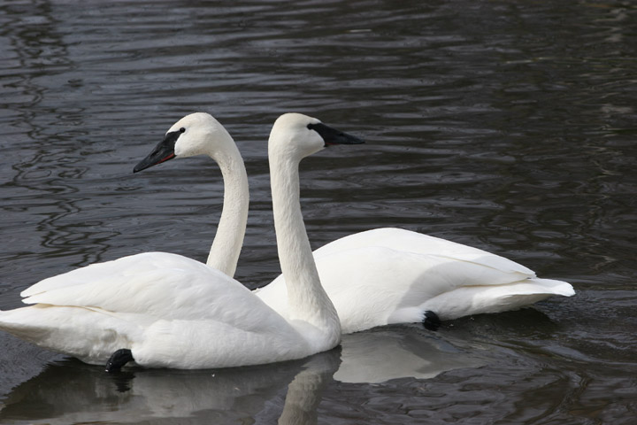
The heaviest bird in North America is the…
Great horned owl
Golden Eagle
Trumpeter Swan
Sharp-shinned Hawk
Up to 28 pounds!
Back to Game Board

Slide 48
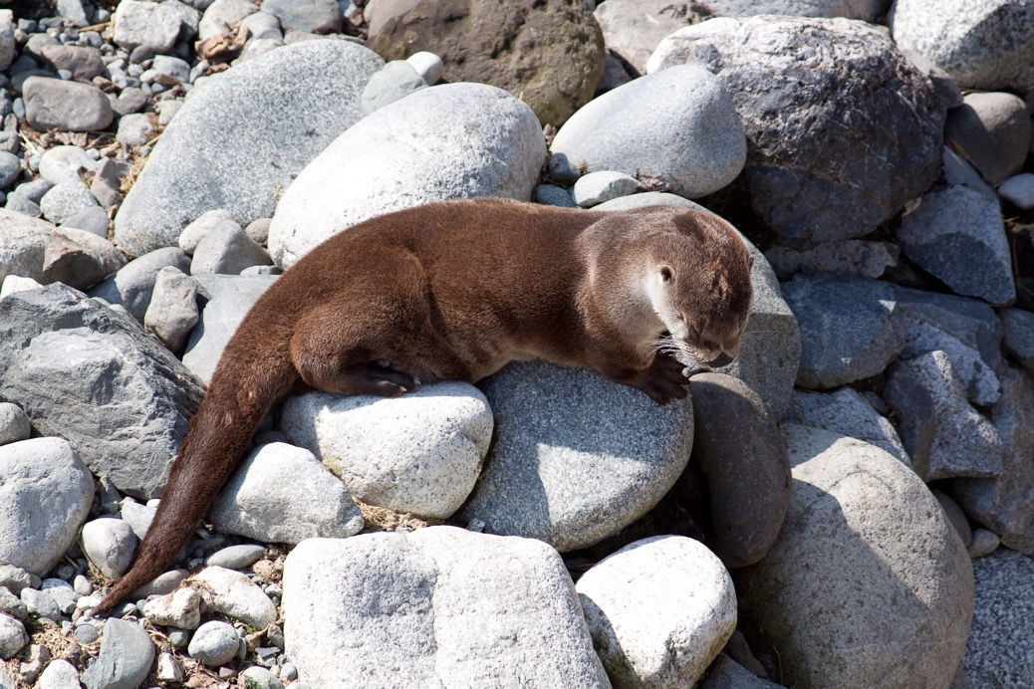
True or False?
River otters have webbed feet.

Slide 49
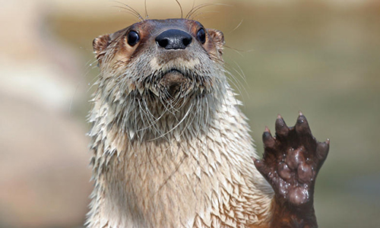
True!
A river otter’s webbed feet allow it to swim with speed and agility underwater.
River otters do almost everything in water from hunting for food to playing with family members.
Back to Game Board

Slide 50
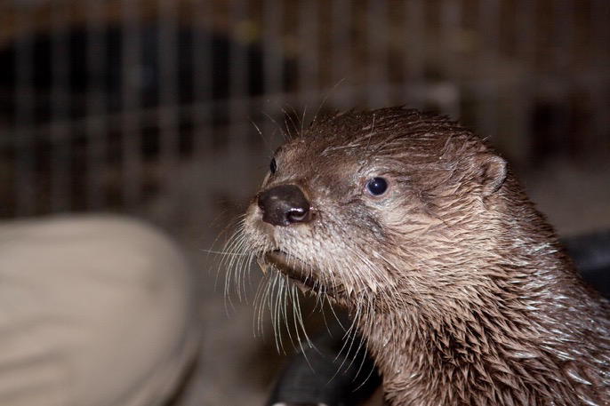
Scientists put animals into groups by how closely related they are to one another.
For example, dogs and wolves are in the Canidae or canine family.
River otters and _____ are in the Mustelidae or weasel family.
Wolverines
Bald Eagles
Bottlenose Dolphins
Polar Bears

Slide 51
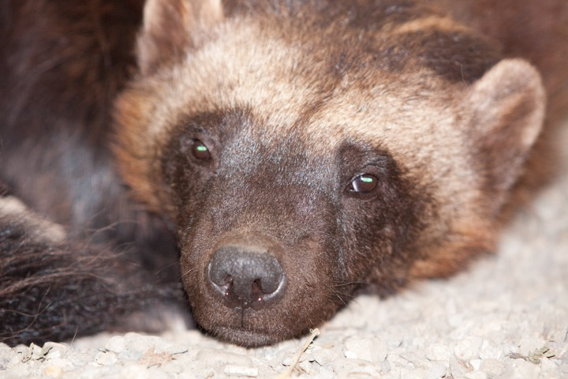
River otters and _____ are in the Mustelidae or weasel family.
Wolverines
Bald Eagles
Bottlenose Dolphins
Polar Bears
Back to Game Board

Slide 52
A river otter can hold its breath for ____ minutes.
50
35
8
2

Slide 53
A river otter can hold its breath for ____ minutes.
50
35
8
2
Back to Game Board

Slide 54
The Marine Mammal Protection Act (MMPA) is a law that protects animals that live in the ocean.
Whales, seals, sea lions and otters are all protected under the MMPA.
What is the only species of bear that the MMPA protects?
HINT – This bear finds its food hunting on sea ice and the Alaska Zoo currently has 1 of them in our exhibits.

Slide 55
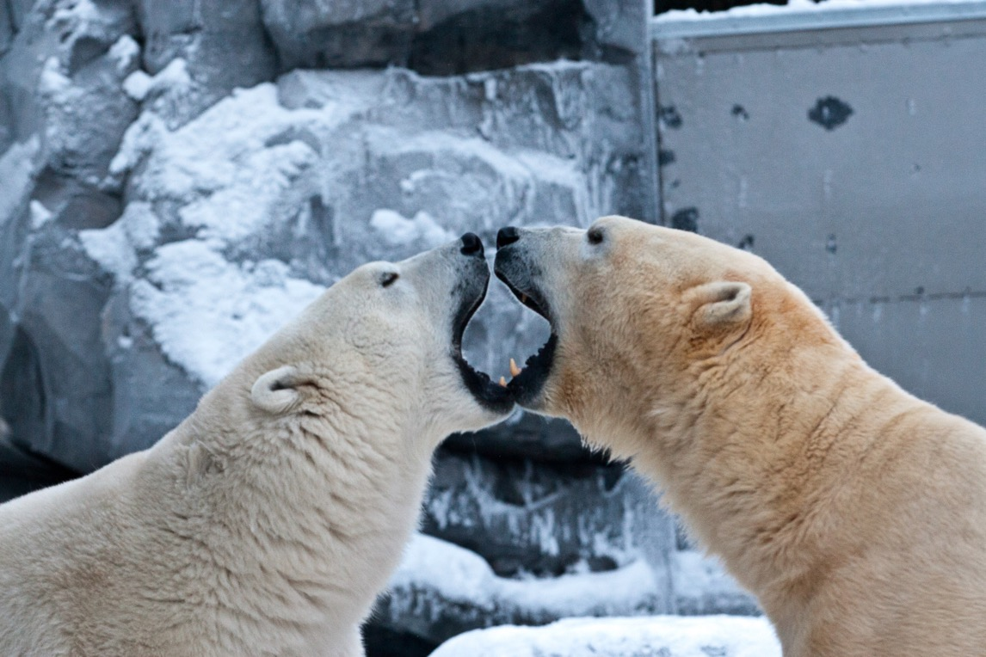
What is the only species of bear that the MMPA protects?
Polar Bear
Back to Game Board

Slide 56
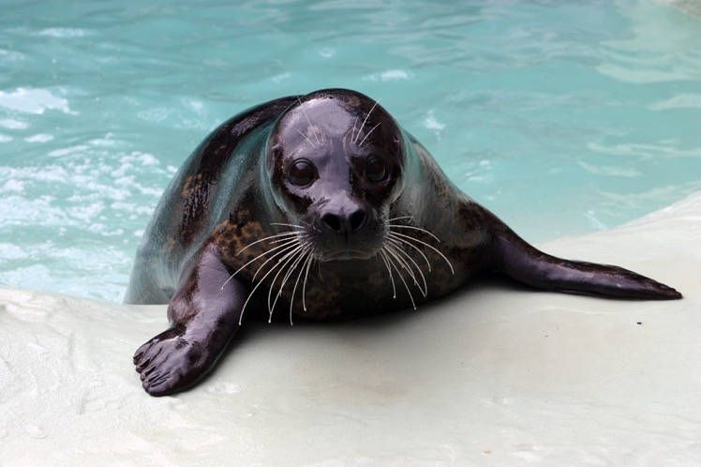
Mammal Characteristics
Seal species nurse their pups for the shortest amount of time for any mammal. Harbor seals only nurse their young for 4-6 weeks.
Besides nursing their young, name one other mammal characteristic.
HINT – There are 4 more!

Slide 57
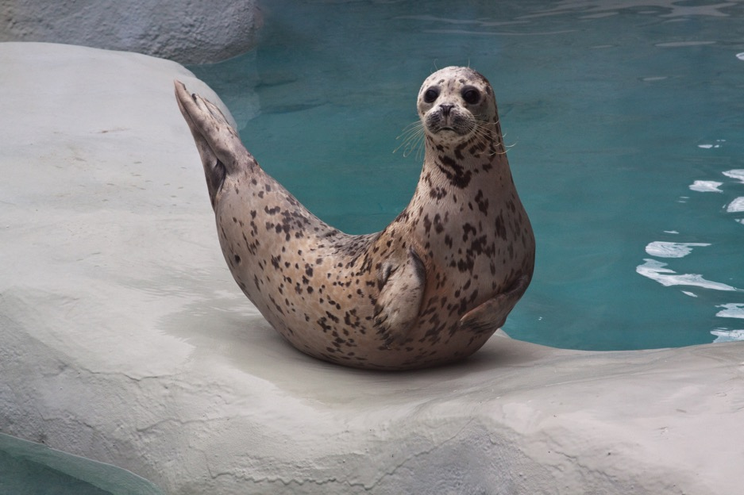
Mammal Characteristics
Nurse young
Give birth to live young (except egg-laying mammals like platypus and echidna!)
Have Hair
Are warm blooded
Breath air
Back to Game Board

Slide 58
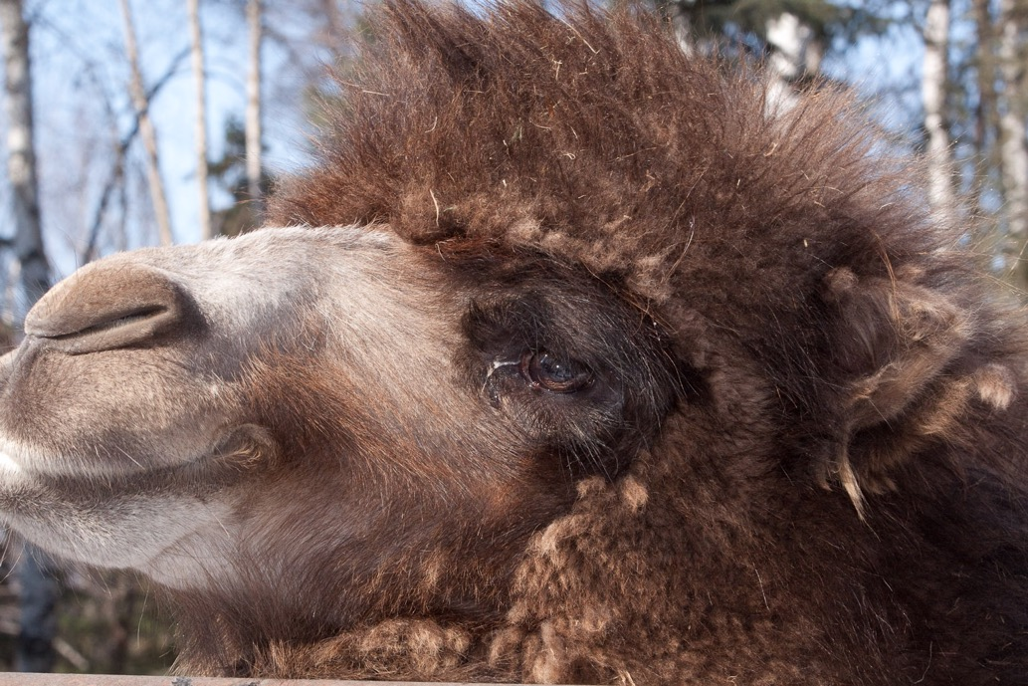
Bactrian camels (like the ones at the Zoo) have ____ humps.
10
3
0
2

Slide 59
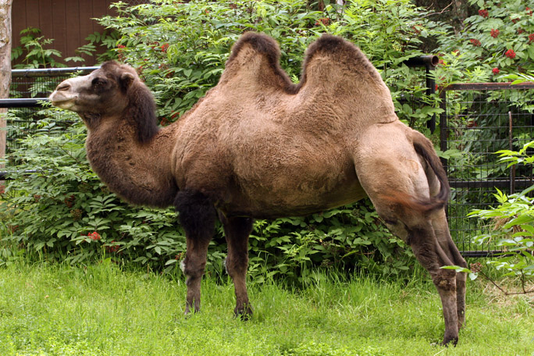
Bactrian camels (like the ones at the Zoo) have ____ humps.
10
3
0
2
BONUS! For 100 more points:
True or False? Camels store extra water in their humps.

Slide 60
False!
Both Bactrian (2 humped) and Dromedary (1 humped) camels store FAT in their humps for times when food is scarce.
Camels CAN store a lot of water but it stays in their blood rather than their humps.
Back to Game Board

Slide 61
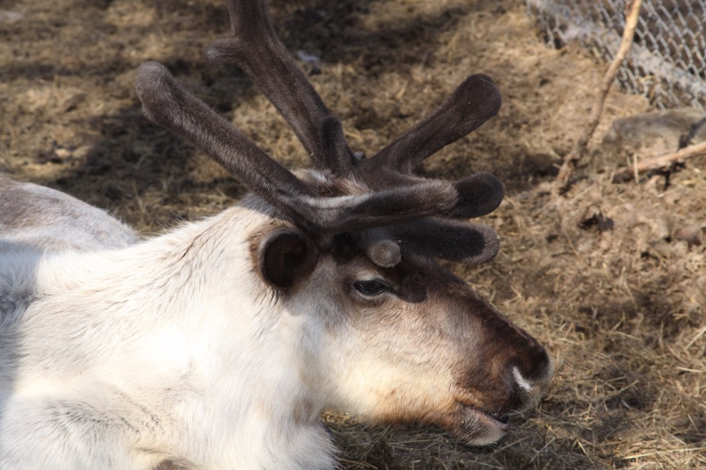
Caribou
Caribou travel up to 3,000 miles per year as food sources become available. This behavior is called ______.
Hibernation
Nocturnal
Migration

Slide 62
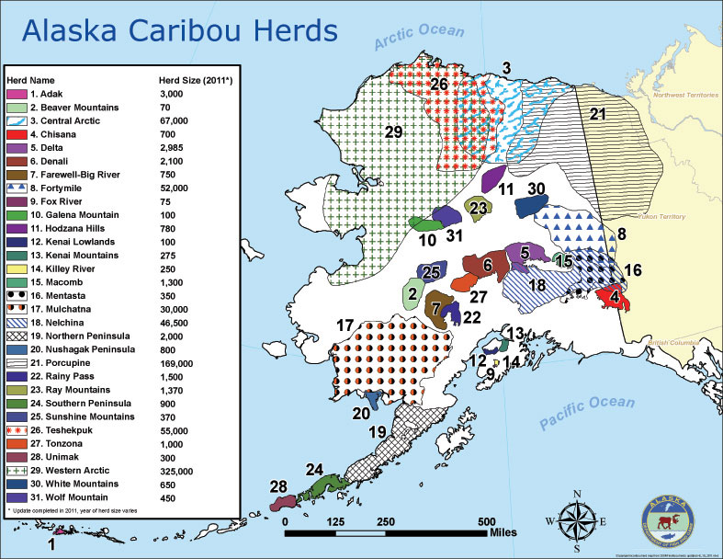
Caribou
Caribou travel up to 3,000 per year when food sources become more or less available. This behavior is called ______.
Hibernation
Nocturnal
Migration
Back to Game Board

Slide 63
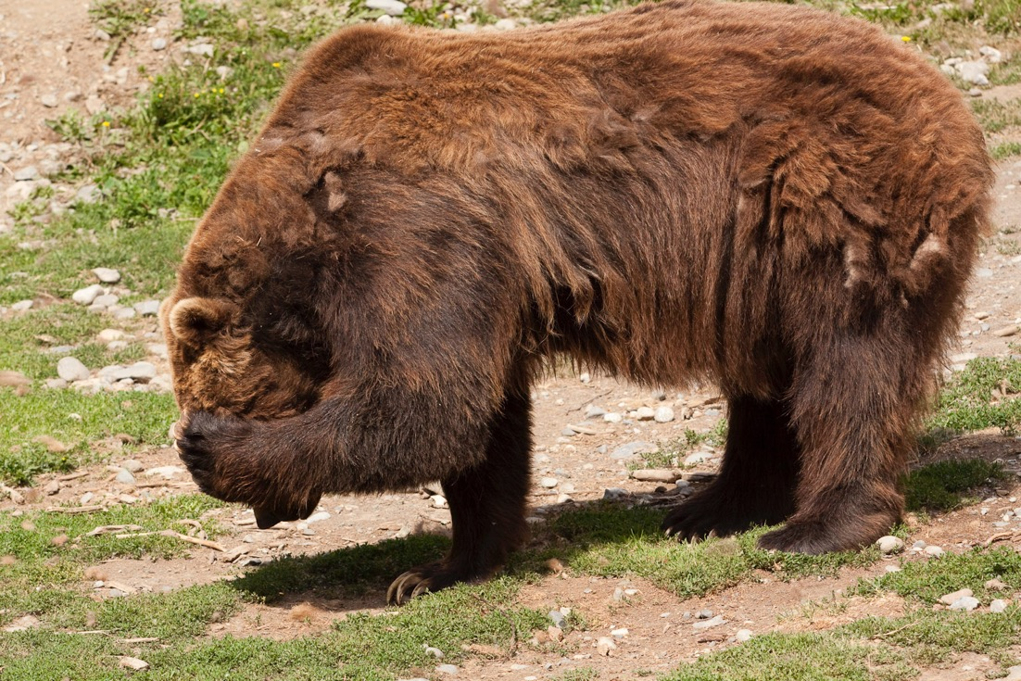
True or False?
Bear do not hibernate at the Alaska Zoo.

Slide 64
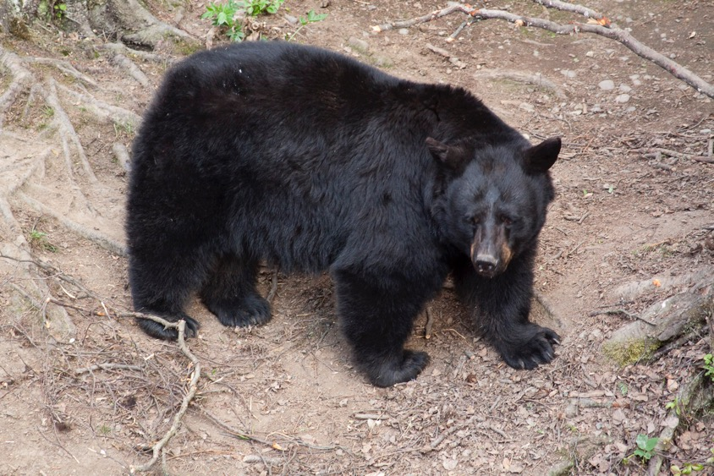
False!
Our brown and black bears hibernate in patterns like wild bears. Zookeepers replicate their natural diet during the year, giving them more food in the summer and slowly less and less into autumn until they are ready to hibernate.
Back to Game Board

Slide 65
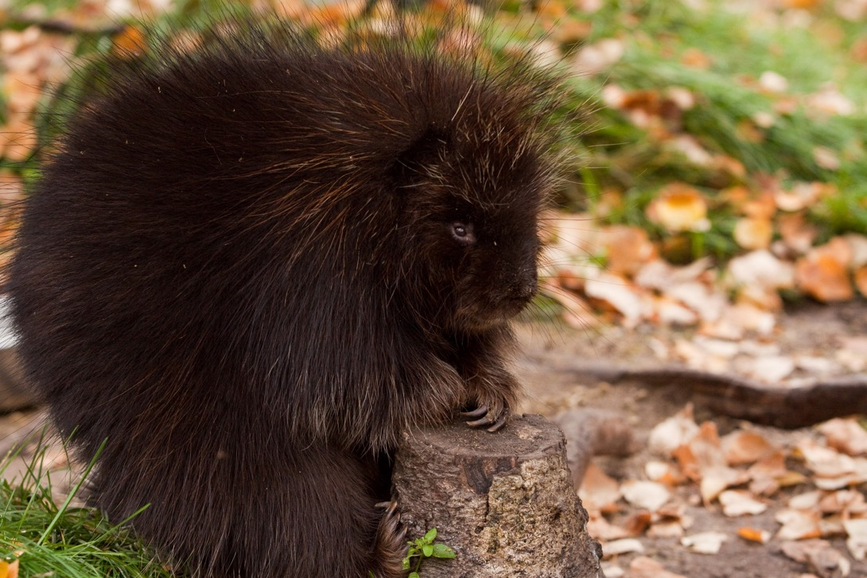
Porcupines are members of the ______ family so their teeth are always growing.
Mustelid
Rodent
Cetacean

Slide 66
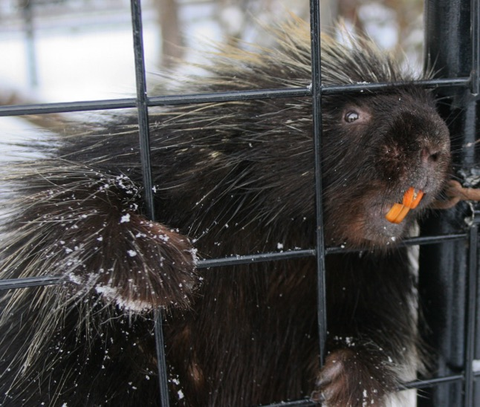
Porcupines are members of the ______ family so their teeth are always growing
Mustelid
Rodent
*Porcupines can be seen gnawing on bark and twigs to keep their teeth worn down!
Cetacean
Brush those teeth!
Not to worry! Orange teeth are a sign that porcupines are getting the right amount of iron in their diets.
Back to Game Board

Slide 67
Snow leopards are active at dawn and dusk making them…
Carnivorous
Nocturnal
Crepuscular
Diurnal
Photo by John Gomes

Slide 68
Snow leopards are active at dawn and dusk making them…
Carnivorous
Nocturnal
Crepuscular
Diurnal
Photo by John Gomes
Back to Game Board

